Slide 1

By: Vikas, Vishal, Shubham, Sachin, Yogesh

Slide 2
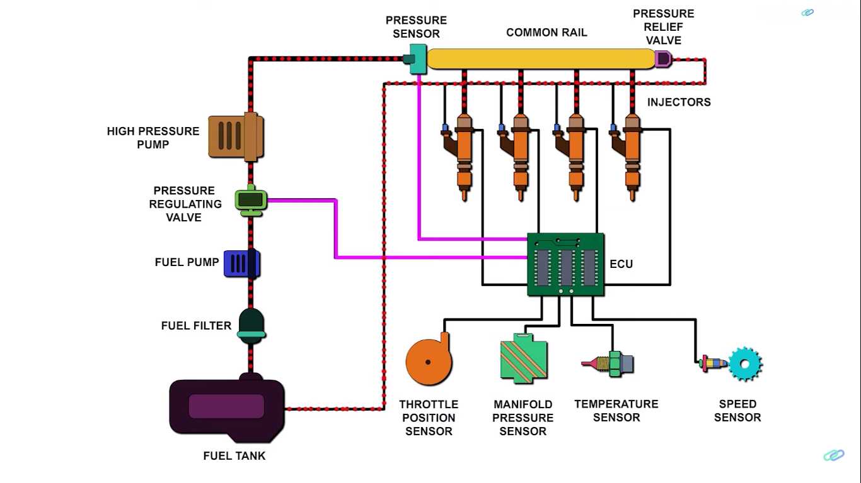

Slide 3
Components Of CRDI
Fuel Tank :- Storage of Fuel
Fuel Filter :- Remove impurities and soot particles if present
Fuel Pump:- Draws fuel from tank to circulate through system
Pressure Regulating Valve:- regulates fuel pressure as per ECU signal
High Pressure Pump:- Increase the fuel pressure as per requirement
Rail Pressure Sensor :- monitors the pressure available in Common rail tube

Slide 4
Components Of CRDI
Common Rail Tube:- Supplying equal amount of fuel to all injectors at a desired pressure
Pressure Relief Valve :- Relieves excess pressure in common rail tube and supply to tank
Injectors :- Injects metered fuel in to cylinder as per requirement under ECU control.
ECU (Electronic Control Unit) :- Monitors and control the real time system as per requirement

Slide 5
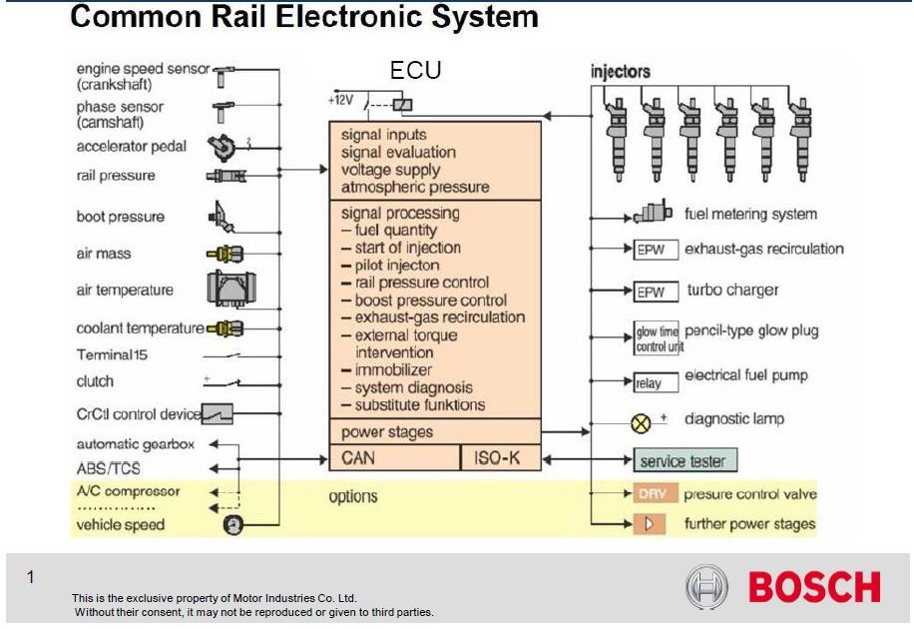

Slide 6
Advantages Of CRDI
For diesel vehicles CRDI helps to improve the performance by as much as 25 percent
It provides more power and makes technology more attractive for passenger vehicles
Engine with CRDI run much more smoothly, with efficiency greatly enhanced by higher pressure possible in the common rail
CRDI method greatly reduces engine and vehicle vibrations.
Give better fuel economy less Emission and noise reduction.
Disadvantage
CRDI engine is little more expensive than older technologies; but the savings in fuel cost can help recoup initial expensive over time

Slide 7
Performance test on IC engine
Historically, the test basically was to find out the power and fuel consumption, also to test effectiveness of cooling, vibration and noise etc.
To find out performance before mass production and fitting it into a vehicle.
To study and understand the performance characteristics of the engine.

Slide 8
Performance Parameters
Power : a) Power developed at the output shaft is known as brake power (b.p.)
b.p.= 2πNT
where, T is Torque in Nm and N is rotational speed in revolutions per second
T=WR W=9.81 × net mass (in kg) applied R=radius in m
b) power developed in the combustion chamber is known as indicated power (i.p.). It forms the basis for evaluation of combustion efficiency or heat release in the cylinder.
c) power utilized in overcoming friction is known as friction power (f.p.).
f.p.=i.p.-b.p.
Mechanical Efficiency= b.p./i.p.=b.p./(b.p.+f.p,)

Slide 9
Performance Parameters
Mean effective pressure: Hypothetical pressure acted upon the piston throughout the power stroke. Pi = (Net work of cycle)/Vs in N/m2 = P mep = Pm = Pi
Indicated Mean Effective Pressure and Brake mean effective pressure (BMEP)
For same mep, larger engine produces more torque
Higher mep, higher will be the power developed by the engine for a given displacement
Mep is basis of comparison of relative performance of different engines
horsepower of an engine is dependent on its size and speed

Slide 10
Performance Parameters
Volumetric efficiency: Volumetric efficiency of an engine is an indication of the measure of the degree to which the engine fills its swept volume.
It is the ratio of the actual volume inhaled during suction stroke measured at intake conditions to the swept volume of the piston.
Fuel-air ratio (F/A): Ratio of mass of fuel to mass of air in mixture
stoichiometric mixture, Rich mixtures and Lean mixture.
Specific Fuel Consumption (sfc): indication of efficiency with which the engine develops power from fuel.
Brake Specific Fuel Consumption : bsfc = mf/BP
Indicated Specific Fuel Consumption : isfc = mf/IP
ήvol = Actual Air Admitted at intake condition / Theoretical Volume Available(Vs)

Slide 11
Performance Parameters
Thermal Efficiency (ηth): Ratio of engine power output to input power i.e. chemical energy in the form of fuel supply.
Indicated Thermal Efficiency (i) given by ηi = IP/(mf * C.V.)
Brake Thermal Efficiency (b) given by ηb = BP/(mf * C.V.)

Slide 12
Basic measurements
Basic measurements to be undertaken to evaluate the performance of an engine are as follows:
Speed
Fuel consumption
Air consumption: air box method/ Viscous flow air method
Brake power : Dynamometer
Heat balance sheet : Temperatures at different locations.

